Slide 1
Using Xcode for iOS Development
Chapter 2

Slide 2
Objectives
  Developing the iOS by Using Xcode
    Creating the Xcode Project
    Project Settings
    Creating the User Interface
    Running the App in the Simulator
    Adding App Behavior
    Dismissing the Keyboard
    App Icons and Launch Images
    Testing iOS Apps on Physical Devices

Slide 3
Creating the Xcode Project
Learn to use the powerful Xcode development environment.
Learn to build a simple but complete iOS app
  “Hello World” app and run it on the simulator and a physical iOS device (iPod, iPhone, or iPad).
Find Xcode in the Applications folder on your Mac.

Slide 4
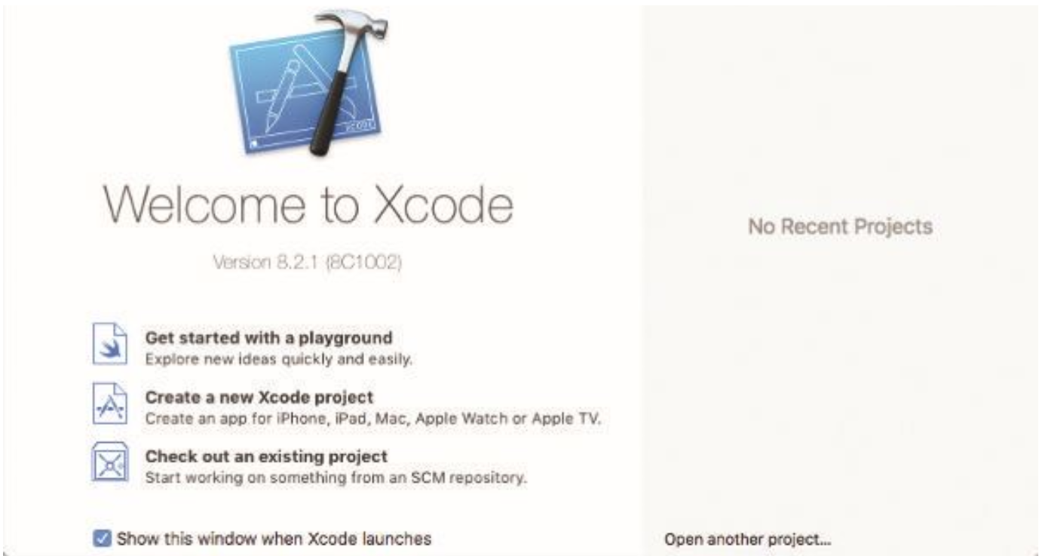
Creating the Xcode Project
After Xcode starts:
Select the Create a New Xcode Project option.
If you don’t have Xcode installed on your Mac, go to the App Store and search for it.

Slide 5
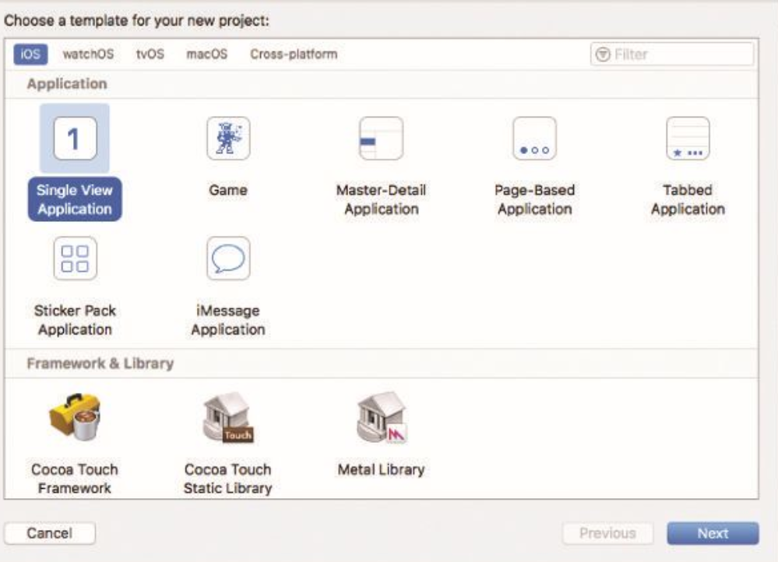
Creating the Xcode Project
Next, notice in the tab bar at the top of the window that you can create projects for both iOS and OS X.
Here is focus on iOS applications.
There are several templates, choose Single View Application.

Slide 6
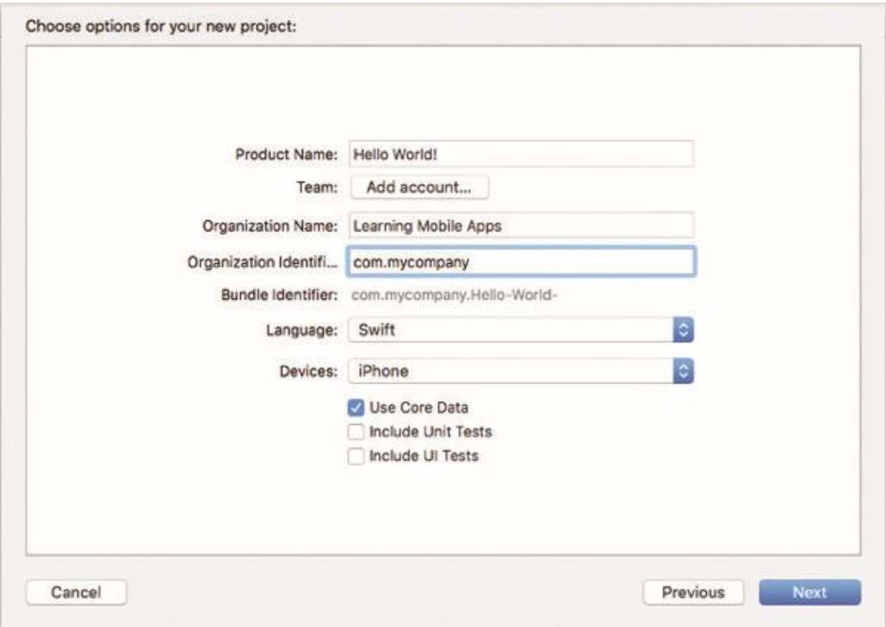
Creating the Xcode Project
The name will show up in the App Store choose a Product Name “Hello World!”
The Organization Name will show up in the App Store, so should be the same for all your apps.
Be sure to set the Language to Swift and devices iphone.

Slide 7
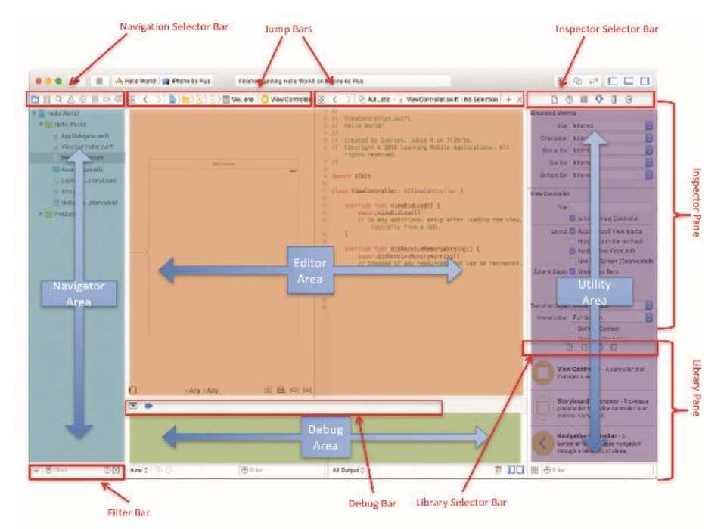
Creating the Xcode Project
Save the project in an appropriate place on the disk to create the project files then Click Create.
The main Xcode workspace window will appear.
There are many areas:
  Navigator Area: displays the item in the Editor Area.
  Utility Area: displays detailed information about the item in the Editor Area.

Slide 8
Creating the Xcode Project
Each main area has a Selector Bar that allows for choosing the specific information shown in that part of the IDE.
For example, the Inspector Selector Bar allows for choosing between six different kinds of information about the document, shown in the Editor Area.

Slide 9
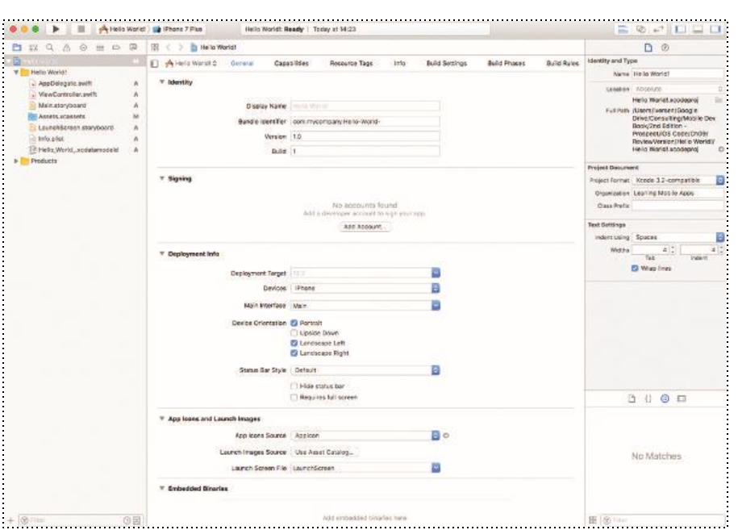
Creating the Xcode Project
Xcode is a very powerful development environment with a lot of functionality.
After created the “Hello World” project, should see the view of Xcode

Slide 10
Project Settings
In the center of the workspace is a summary of the app and several app-wide settings.
The first section enables you to specify the version and build for the app.
The version is used when the app is published to the App Store.
The build number is for internal use by the developer.

Slide 11
Project Settings
Apps are typically built using the latest available base SDK, so if use features in a later SDK than deployment target, it will need to insert checks in the code to make sure app doesn’t crash on devices with older versions of iOS.
Specify which device orientations are supported. By default, iPhone apps support portrait and landscape, left and right, but not upside down.

Slide 12
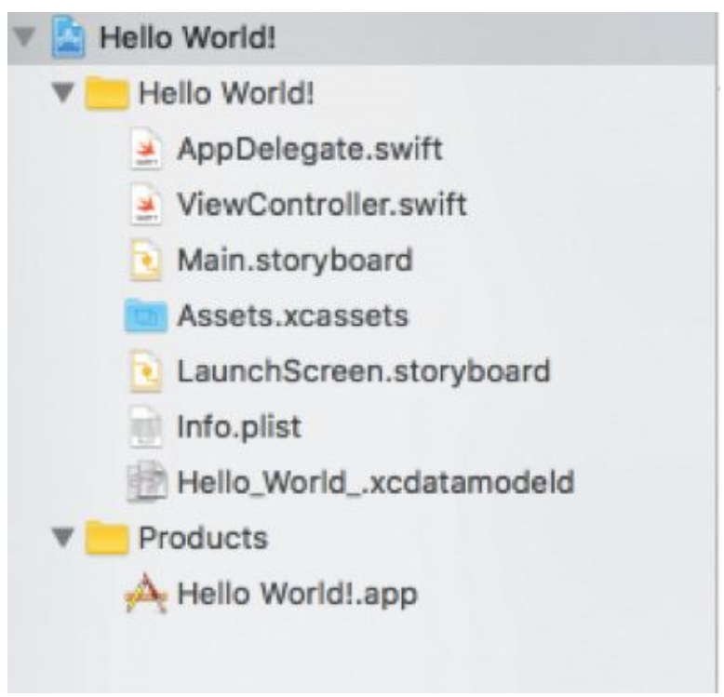
Project Settings
On the left, in the navigation area, the files that Xcode created.
The exact number and types of files created depends on which choices you made when creating the project.
An overview of some of the files and folders created in this project:
  AppDelegate.swift—The App Delegate manages issues related to the entire app and are primarily used to manage the life cycle of the app—how it is started, what happens when it goes to the background, and so on.
  ViewController.swift—The view controller contains the code that controls the user interactions with the app.
  Main.storyboard—The storyboard is used to design the interaction between multiple screens in the app, as well as designing the layout of the individual screens.

Slide 13
Project Settings
An overview of some of the files and folders created in this project:
  Assets.xcassets—This folder contains all the images, including icons, needed for the app.
  LaunchScreen.storyboard—When your app launches, the launch screen should contain a simplified view of the app user interface that can be loaded quickly, so the user gets a better experience when starting the app.
  info.plist—This file contains a few app-specific settings. Most of these are controlled in other parts of Xcode.
  HelloWorld.xcdatamodeld—This file contains information about the Core Data model for the app, which is where you can save data for the app.
  Products—This is your compiled app file.

Slide 14
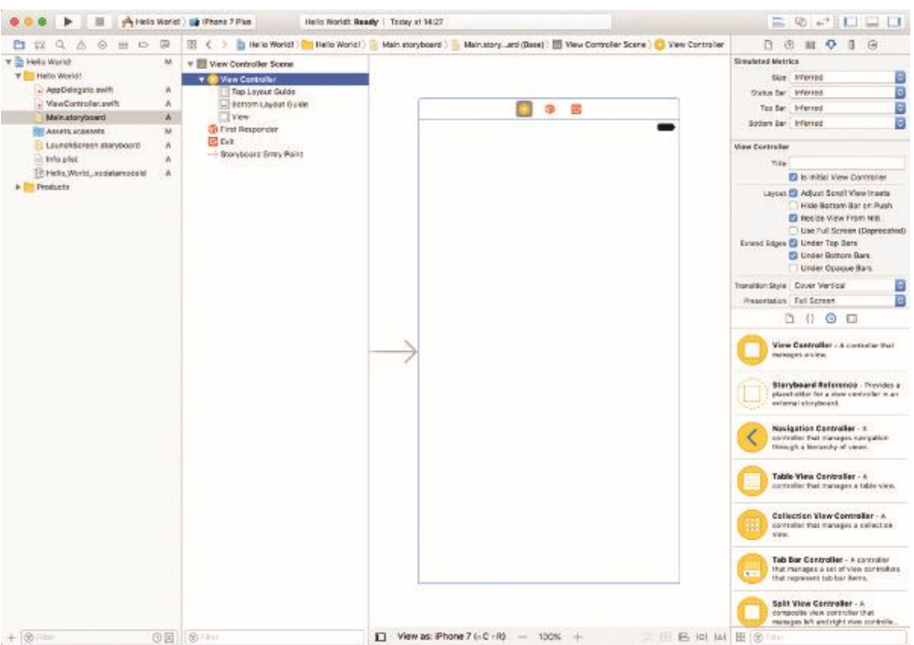
Creating the User Interface
To open a file for editing in Xcode, you need to click it only once.
1. Click once on the Main.storyboard file. This opens the file in Interface Builder where you can easily create the user interface for your app.
  With the storyboard open, you can drag user interface elements from the utility pane on the bottom right and control a range of settings in the top of the utility pane.

Slide 15
Creating the User Interface
2. In the lower right of the utility area, you should see the Object Library, which contains all the user interface elements you can use in your app.

Slide 16
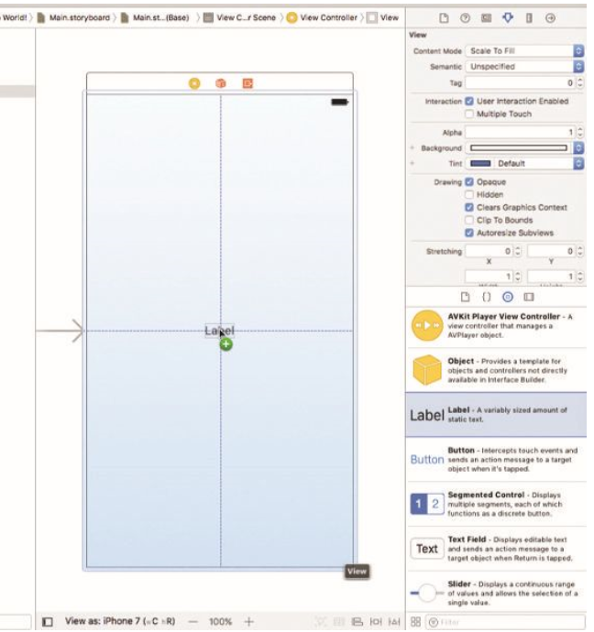
Creating the User Interface
Start by dragging a Label onto the user interface canvas.
You may have to scroll down the list of controls to find the Label.
You can also use the Search bar below the controls and type in label.
Notice that you get blue dotted guidelines as you drag the label around.
Drag it to the middle of the screen.

Slide 17
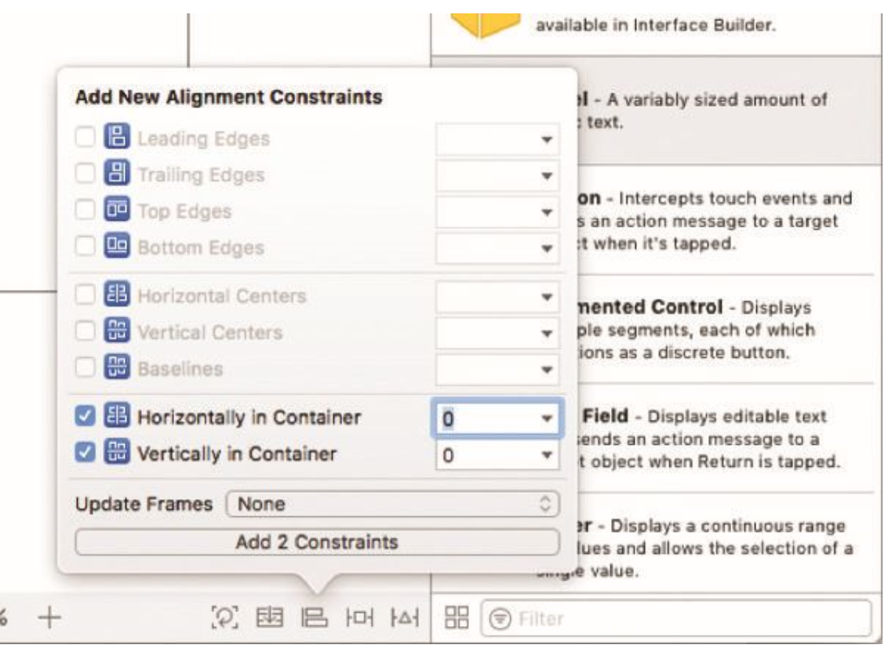
Creating the User Interface
3. Double-click the label to change the text of it to Hello World! and then press Enter.
We want the label to be centered on the screen when you run the app.
Click on the Align button at the bottom right of the Interface Builder window and check the last two options, which will center the control horizontally and vertically in the container. Then click Add 2 Constraints.

Slide 18
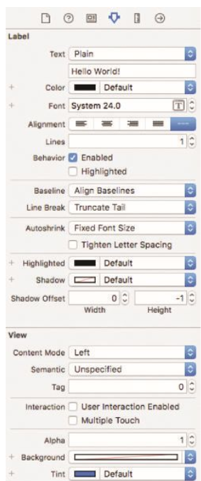
Creating the User Interface
4. Above the utility area on the right, you have a little menu bar of five items.
The fourth one is the Attributes Inspector, which enables to set many properties for the currently selected user interface element.
For the label, you can just need to change the font size to 24.

Slide 19
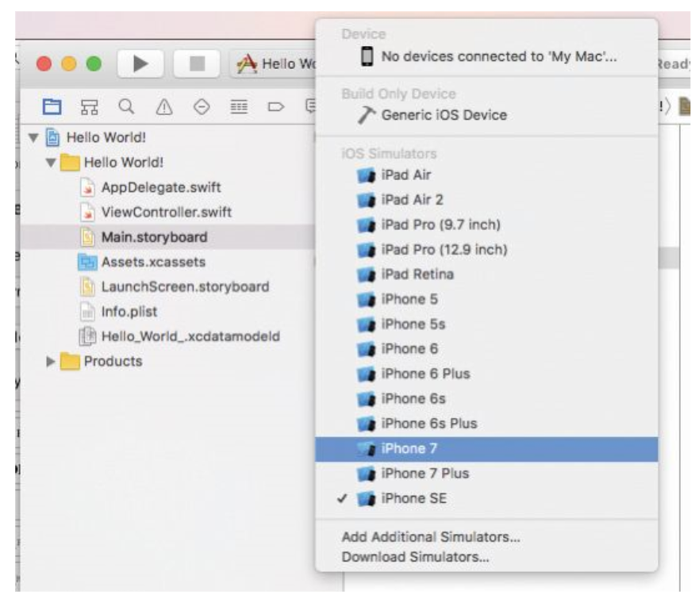
Running the App in the Simulator
In the top-right corner of Xcode, you will see a big Run button, and next to that is something called a Scheme, which allows you to choose which device is targeted.
Click the right side of the Scheme and choose one of the iPhone simulators.
If you have a physical device connected to your computer, it will also show up in this list.

Slide 20
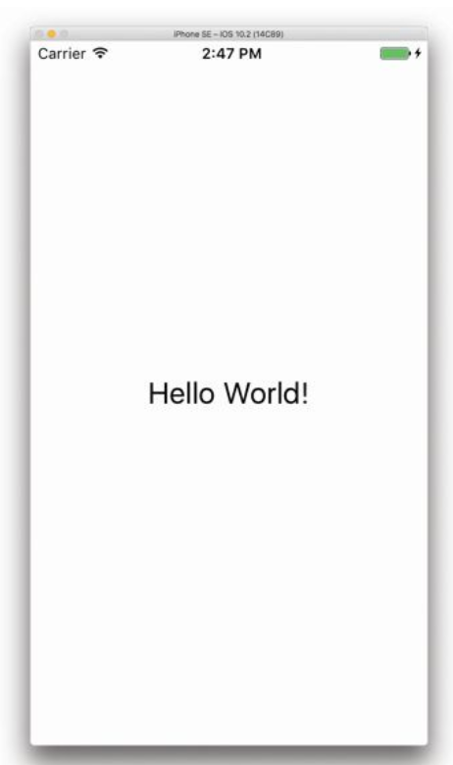
Running the App in the Simulator
Click the Run button on the top left of the Xcode toolbar and wait a few seconds for the Simulator to launch with your app.
You can control how the Simulator looks and behaves in the Hardware menu.
If you choose a device with a high-resolution screen, it may not fit on your computer screen comfortably. In that case, you can go to Window > Scale and choose a zoom level.

Slide 21
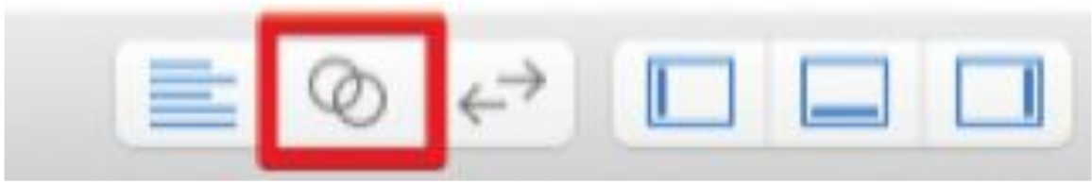
Adding App Behavior
Adding app behavior means add some action to the app.
The action is the name entered and say Hello to the user by name.
1. Return to Xcode and click Stop to quit the simulator. Then make sure Main.storyboard is open in the editor.
2. Click the Show Assistant Editor button in the top-right corner of the Xcode window. (It’s the second button from the left)
ViewController.swift. This opens an extra editor that by default contains the file that best matches what is displayed in the main window.
For the storyboard, that should be the corresponding
If this file isn’t showing up in the Assistant, click the Related Items icon at the top left of the editor (it’s the one with four small squares).

Slide 22
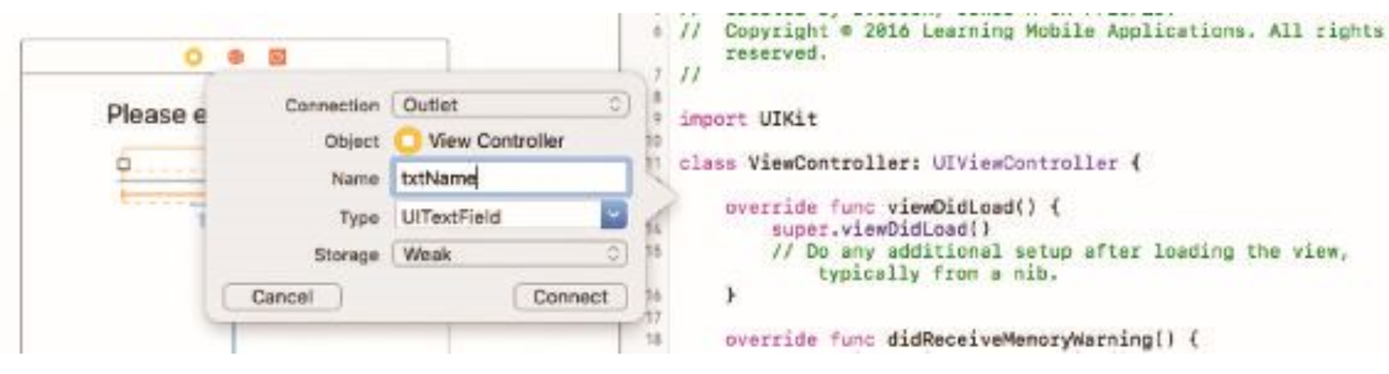
Adding App Behavior
3. Create outlets for user interface elements that we want to be able to access from the code.
To create the outlets, control-drag from the text field to the view controller below the class line.
4. Enter txtName in the Name field and click Connect.
You should now have this line of code in ViewController: @IBOutlet weak var txtName: UITextField

Slide 23
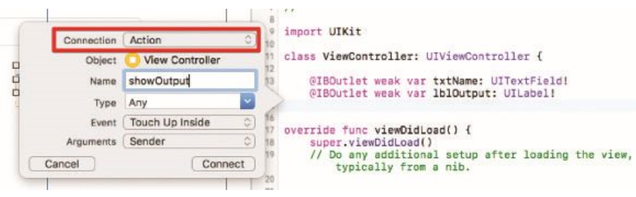
Adding App Behavior
5. Do the same for the bottom label, naming it lblOutput.
You can control-drag from the sidebar to create this outlet.

Slide 24
Adding App Behavior
6. Add the code for the button.
The first step is the same: control-drag from the button to the view controller below the properties for the text fields and label, in the top drop-down choose Action instead of Outlet
Give it the name showOutput. For the Event, we will use the default Touch Up Inside.
Touch Up Inside means that the button responds to events where users touched the button and then released their fingers while still inside the button.
The Arguments is Sender.
Click Connect.

Slide 25
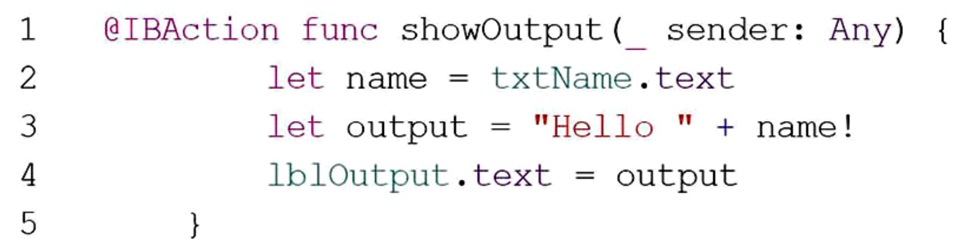
Adding App Behavior
7. You will now have a method called showOutput. Between the curly braces of this method, enter the code
8. Run the app and test it by entering different names and touching the Tap Here! button.

Slide 26
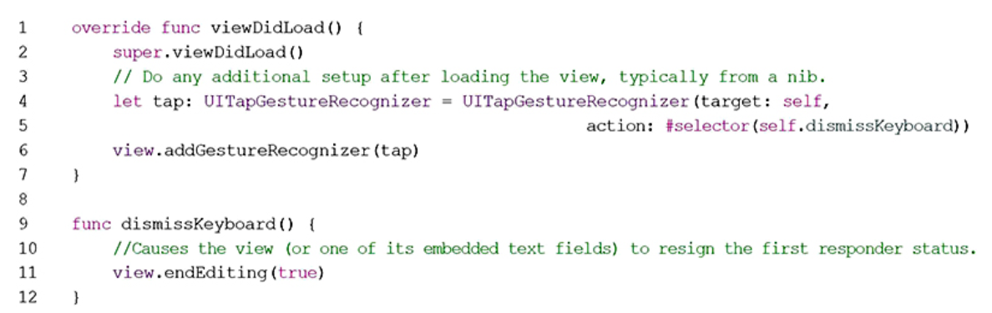
Dismissing the Keyboard
To get the keyboard to disappear, you have to add a little code to the program.
The code to add to viewDidLoad in ViewController.swift and a new method called dismissKeyboard.
Notes:
Line 4 creates a constant called tap of the type UITapGestureRecognizer. This object listens for taps, and when it recognizes a tap, it calls the method identified in the #selector section. In this case, it will call the dismissKeyboard method. ▪ Line 6 adds the tap object to the view, which means that it will listen to any taps that occur anywhere in the view. ▪ Line 11 inside the dismissKeyboard method simply calls the endEditing method, which looks at the current view and any subviews looking for textfields. If it finds any, those text fields are forced to end what is called first responder status, which in effect means that it loses focus and the keyboard disappears.

Slide 27
App Icons and Launch Images
The Assets.xcassets folder is called the Asset Catalog
  introduced with Xcode 5
  manage all the images in app, including app icons and launch images.
App Icons are graphical images that are used to indicate your app on the home screen of the iOS device your app is running on.
When you create the icon for your app, you should be prepared to create it in a number of resolutions so that it looks great on different devices, and for various uses within the app as well.

Slide 28
App Icons and Launch Images
The icon is used in several places:
  On the home screen, to give the user an easily recognizable image of your app.
  In Spotlight results when the user is searching on the device.
  In the Notification area, when a new notification is displayed..
  In the Settings app, where the user can change various settings for your app.
In each area, the icon is supplied in different resolutions, and the resolutions are differ between iPad and iPhone.
There can also be differences depending on app is targeting such as iOS 7 or versions of iOS earlier than that.

Slide 29
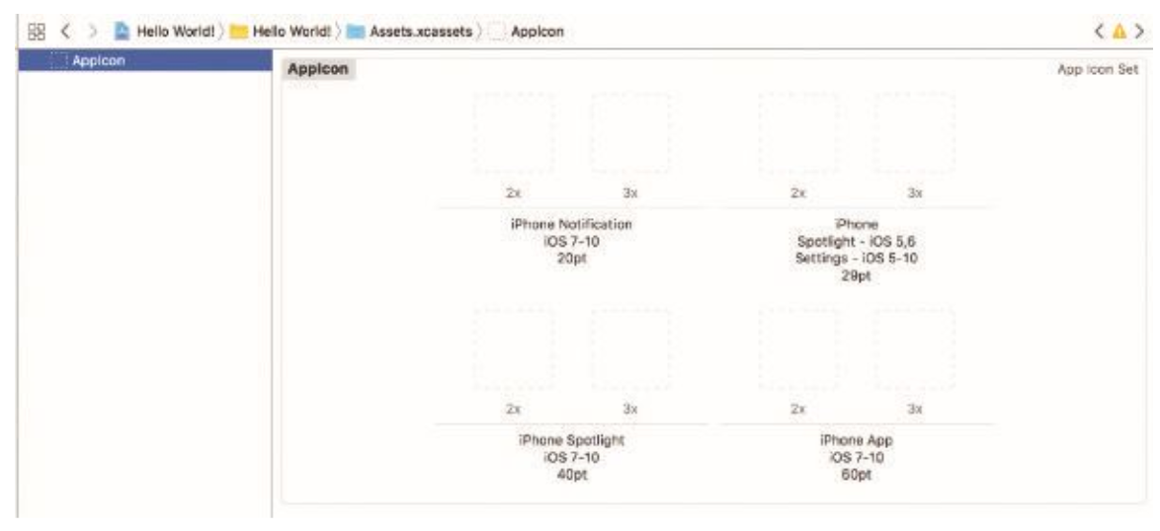
App Icons and Launch Images
Click the Assets.xcassets folder and then AppIcon.
On the right, you see eight spots for icons.
Below each of these images, it says either 2x or 3x, indicating that the real pixel count is either double or triple in each direction (a 40pt image in 2x would be 80x80 pixels and in 3x would be 120x120 pixels).
The 2x designation is for retina displays and 3x for retina HD, which is used on the iPhone Plus models.

Slide 30
App Icons and Launch Images
Manually creating all the proper resolutions for an icon is a lot of work.
There are templates available for various image programs and online services that can handle some of them.
One example is the website MakeAppIcon, where you can upload a single high-resolution image and then download a compressed file with all the image sizes you need—including for Android and Apple Watch apps.

Slide 31
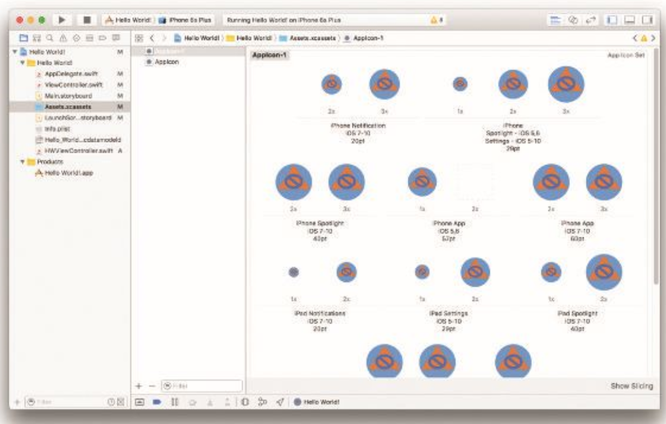
App Icons and Launch Images
Once you have uncompressed the downloaded file, you can get it into the Asset catalog, simply by dragging the entire folder of icons into the Asset catalog below AppIcon.
This will create a new entry called AppIcon-1, with all the slots populated with icons, .
You can just delete the original AppIcon entry and rename the new one to AppIcon.

Slide 32
App Icons and Launch Images
You can test how the icon looks by running the app in the simulator and then clicking the Home button (Hardware > Home) to get to the home screen, where the app icon will be shown along with the app name.
You can see the Spotlight icon in the simulator if you click the home screen and drag down.
This will pull down a search field. Type Hello into the resulting search field, and the icon will show up in the search results.

Slide 33
App Icons and Launch Images
To have your app listed in the app store, you also need to supply icons in sizes of 512x512, 1024x1024, and 1536x1536 pixels.
The other option that is available in the asset catalog is launch images. A launch image is shown as the app is launching.
Apple recommends that your launch image is a blank version of the app’s first screen. This way, the user will quickly see the app and what it looks like before it is filled in with data.

Slide 34
App Icons and Launch Images
Landscape | Portrait | Device
1920 x1080 pixels | 1080 x 1920 pixels | iPhone Plus
1334 x 750 pixels | 750 x 1334 pixels | iPhone 6 iPhone 7
1136 x 640 pixels | 640 x 1136 pixels | iPhone 5 iPhone SE
Launch images are also supplied in different resolutions, depending on the device.

Slide 35
Testing iOS Apps on Physical Devices
There are certain features where it is necessary to test on a device.
Some limitations of the simulator, requiring to test on a real device:
  No phone or messaging—The Simulator can toggle the in-call status bar, but doesn’t make or receive calls.
  Access to camera
  Realistic access to network (perhaps to test for network coverage in a specific location)
  Realistic user touch interactions

Slide 36
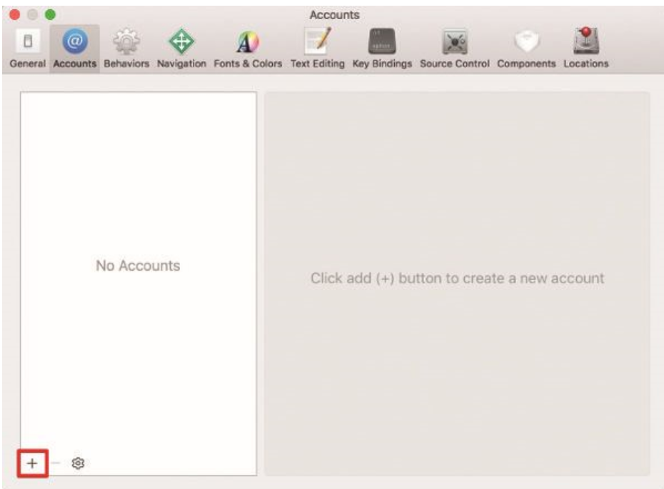
Testing iOS Apps on Physical Devices
Apple has greatly simplified set up and manage physical devices for testing.
There are really just a few simple steps:
Create an Apple ID at https://appleid.apple.com.
Add your Apple ID to Xcode by choosing Xcode > Preferences﻿… > Accounts > + > Add Apple ID﻿

Slide 37
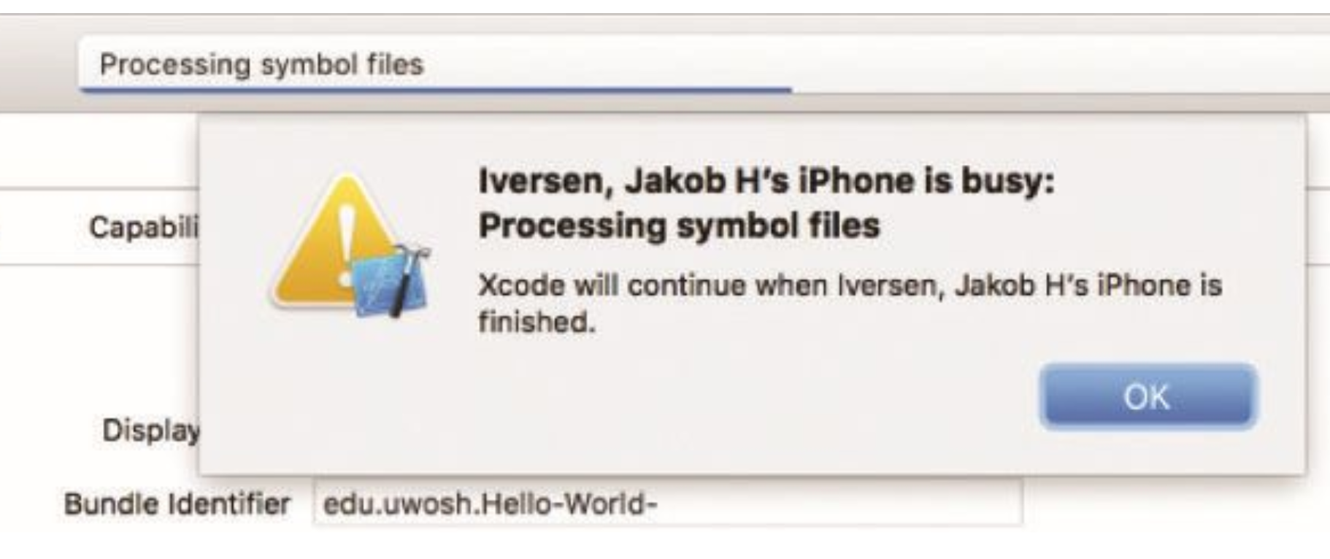
Testing iOS Apps on Physical Devices
3. Enter your Apple ID user name and password and click OK.
4. Connect a physical device.
5. Select your physical device in the Scheme list where the Simulator model is listed
6. Click the Run triangle button.

Slide 38
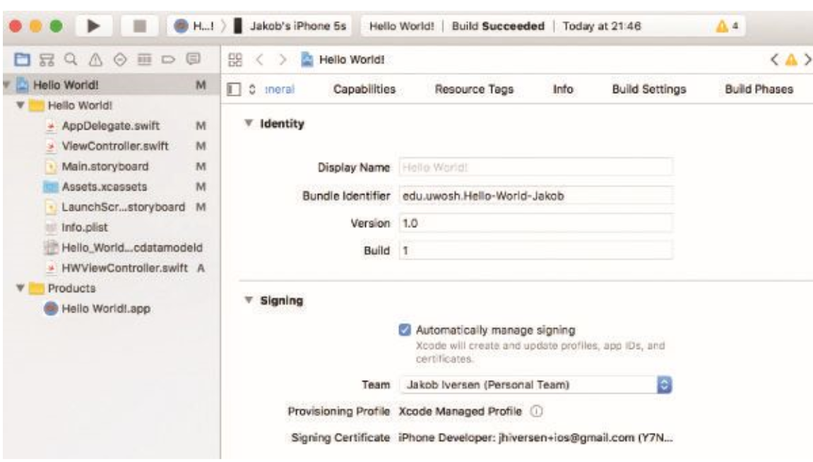
Testing iOS Apps on Physical Devices
Xcode will automatically sign the app and install the necessary profiles on the device in order to run the app.
You can check the status of the signing process, and switch between development teams if you have multiple teams or multiple Apple IDs in the Project.

Slide 39
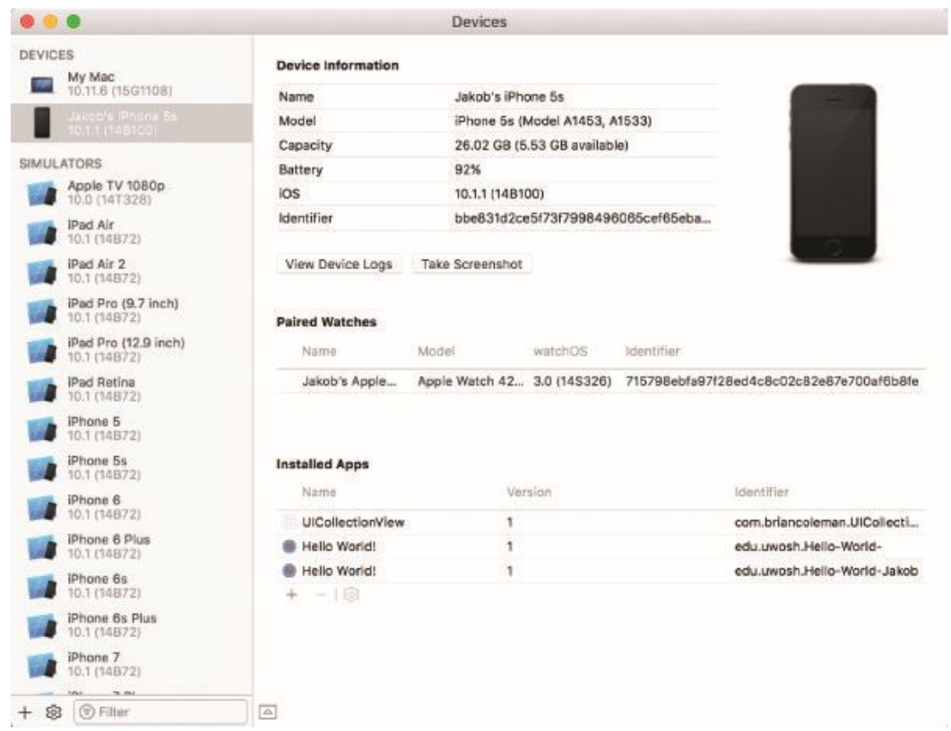
Testing iOS Apps on Physical Devices
As you run your app on the device, you may find it helpful to view the Devices window. Go to Window > Devices.
This will show you the currently running device and any simulators available.

Slide 40
Conclusion
You have built your first iOS app. You created an Xcode project, designed and coded a user interface, and finally made the app do something.
Along the way, you learned the process of iOS app development, the Xcode development environment, the components of an iOS app, and how to run the app on a physical device.

Slide 41
Comments !!
Questions

